Slide 1
Transfer learning
Image Recognition

Slide 2
Problem Statement
Greendeck is a vendor who helps retailers in identifying / classification of images in correct categories & further helps in price intelligence.
This problem has potentially two aspects :
Image recognition - Identify & classify images in correct categories.
Matching of products & retrieve further details (such as price / user ratings etc.)
As part of our project, Our aim is to build a model to recognize / classify images in potential categories. However second requirement is not in scope (future enhancements).
This problem comes under the category of “multi-label” classification.

Slide 3
Solution Approach
Keras library provides a set of deep learning models along with pre-trained weights (for e.g. ImageNet dataset). These pre-trained models can be used for image classification, feature extraction, and transfer learning.
We are trying to follow typical “CRISP – DM” technique to tackle this problem.
Business Understanding :
Our aim is to build a model to recognize / classify images in potential categories.
Data Understanding :
We have been provided a dataset with around 6000 images (.JPG files).
There is another excel sheet which contains the individual image file & corresponding category which that image represents. This is our "Target" variable.
The features extracted from pre-trained model can be utilized as our "independent" variables in model building.
Data preparation :
Load the image dataset & excel sheet (as Dataframe).
Sanity checks of the Dataframe (missing values / incorrect categories / duplicates etc.).
Create 2 lists (image file & corresponding Target variable) with 1-2-1 mappings.
Basic EDA ( count plot to understand the frequency of different categories)

Slide 4
Solution Approach – Contd…
Model building :
Use a pre-trained model in Keras, e.g.VGG16, to extract features of a given set of images.
VGG16 is a convolutional neural network model for image recognition. The input layer takes an image in the size of (224 x 224 x 3), and the output layer is a softmax prediction on 1000 classes.
For feature extraction, we use the model only till last max-pool layer in VGG16 architecture.
Output from last max pool layer is flattened to collapse a feature from the model (labeled by 7 x 7 x 512).
Given a dataset of N images, we can repeat the process of feature extraction for all images in the dataset, leaving us with a total of N x 21,055-dim feature vectors.
We can then use this dataframe of feature vectors along with corresponding "Target" variable to train model further.
Iteration / evaluation :
Create multiple models using different inputs to assess accuracy / model-loss.
Processed raw input image (224, 224, 3)
Features extracted from last Convolution layer (7, 7, 512) of pre-trained VGG16.
Use different optimizer / Learning rate values to understand how it affects the performance.

Slide 5
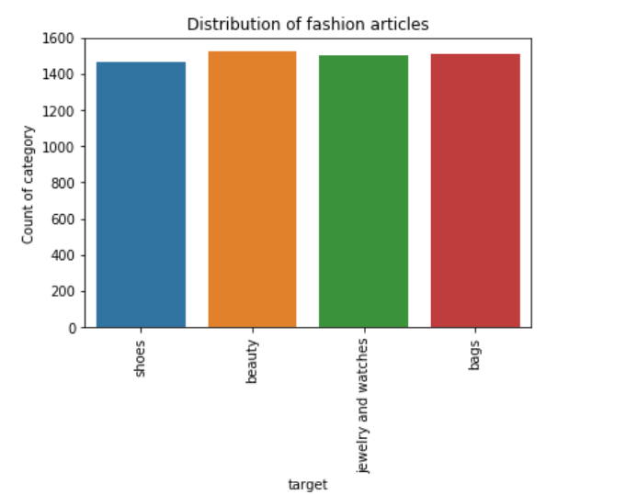
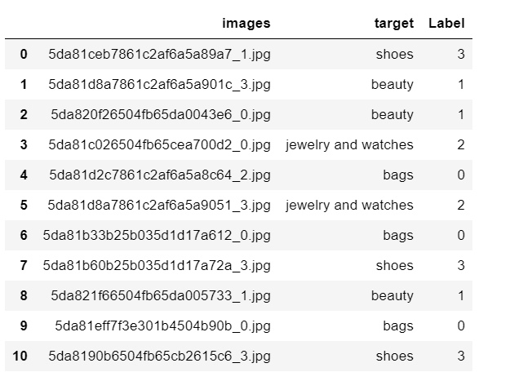
Exploratory Data analysis (EDA)
We have been provided 6000 images (.JPG files).
Below table shows frequency distribution across different categories. We also created a Seaborn Countplot to visually demonstrate the same.
Category | Count
Beauty | 1524
Bags | 1508
Jewellery & Watch | 1503
Shoes | 1465
Key inferences :
Input data shows fairly equal distribution across 4 categories.
Images in folder are randomly distributed. Hence any samples used for Train / Test should have good distribution (prevent sampling bias).

Slide 6
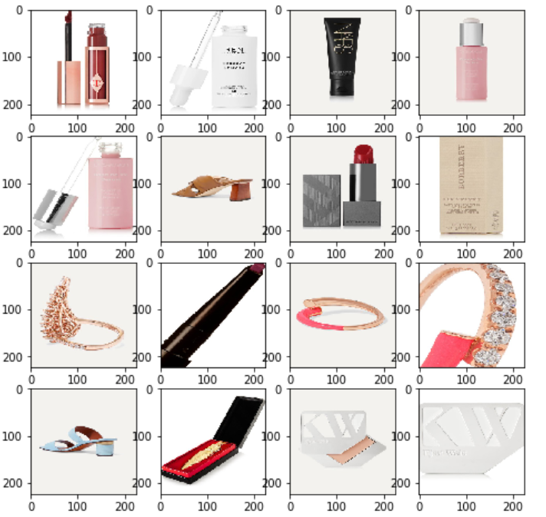
Exploratory Data analysis (EDA) - Contd.
We have displayed sample images from the Train folder as below.

Slide 7
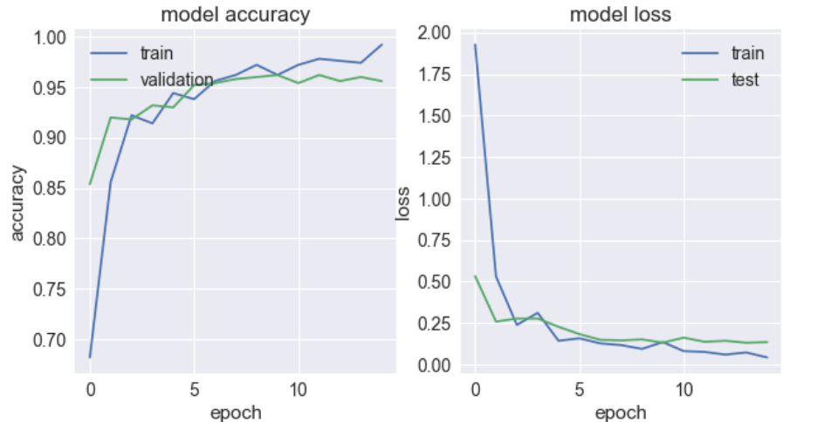
Model evaluation / performance
Model created using raw input images shows approx. 72% Accuracy on test data. We have tried further combinations using different “Optimizer / Learning rate / Number of epochs” combinations.
Model created using Features extracted from last Convolution layer shows approx. 95% Accuracy on test data.

Slide 8
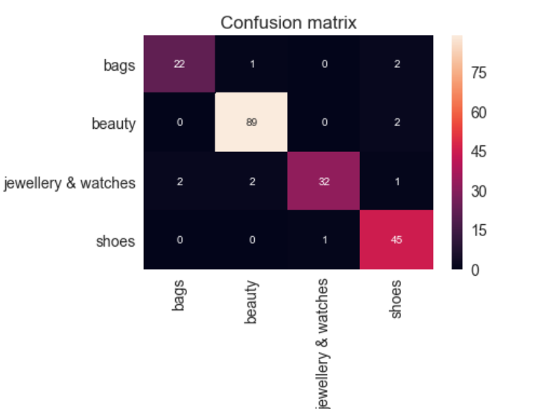
Conclusion
The model that we have created using Feature extracted input shows very good accuracy. This has been demonstrated by feeding “Unseen” images to validate the predictions.
Model created using Features extracted from last Convolution layer shows approx. 95% Accuracy on test data.
There are very small number of incorrect predictions. For e.g. Shoes & bags, But this could possibly because similar leather texture / shape. However as a whole it is demonstrating good accuracy.

Slide 9
Thank You
Dr. PREETI GUPTA

